Slide 1
UG Program – BE Information Technology
Major Project Presentation Semester –VIII
31st January 2026

Slide 2
FlowTech
AY 2025-2026
Group No.- 15 | Registration No | PRN
Sahil Vilas Bhatkar | T-22-0048 | 2022016402122777
Aditya Shankar Dhuri | T-22-0108 | 2022016402127844
Mayur Balasaheb Garje | T-22-0247 | 2022016402131664
Under the Guidance of | Affiliation and Designation
Guide | Prof. S Sankareswari
Industry Mentor | Mr. Pundalik Desai
Primary SDG – SDG 9: Industry, Innovation and Infrastructure
Secondary SDG – SDG 12: Responsible Consumption and Production

Slide 3
Institute’s Vision
The academy aspires to nurture students as leaders who are in tune with global trends, equipped with engineering knowledge and practical skills, to excel in creativity and innovation in order to play their part in technological advancement of the nation.
Department’s Vision
To provide excellent Information Technology education and aspire to nurture students as leaders who are in tune with global IT Trends
Vision and Mission Statements
Institute’s Mission
To become foremost seat of advanced technical learning as a center of excellence in the region.
To offer state of the art facilities and quality education at affordable cost
To inculcate in students the culture of ‘Play Hard and Play Fair’.
To advance sustainable development in the region through opportunities for entrepreneurship and industry-institute interaction.
To create a generation of young professionals who appreciate in all its aspects the necessity of balance between technological advances and traditional values.
Department’s Mission
M1-To Enrich students by rigorously implementing quality education (Knowledge)
M2-To empower the students with the required skills to solve the complex problems of modern society by following collaborative, multidisciplinary and sustainable activities (Skills)
M3-To imbibe professional ethics and social values in the students and make them responsible citizens (Attitude)

Slide 4
Program Educational Objectives (PEOs)
PEO1
01
PEO 2
02
To provide learners with Core Competence in mathematical, scientific and basic engineering fundamentals necessary to formulate, analyse and solve hardware/software engineering problems.
To prepare learners to solve business-centered problems by identifying, analyzing, developing, and implementing information system-based solutions with modern programming tools. To encourage learners to use best practices and implement technologies to enhance information security and enable compliance, ensuring confidentiality, information integrity, and availability.
PEO 3
03
PEO 4
To prepare learners for successful career in Indian and Multinational Organizations, Identify and evaluate current and emerging technologies. To provide our graduates with learning environment awareness of the life-long learning. To motivate students to pursue it throughout their career and higher studies. To encourage and motivate learners for Research & Development and entrepreneurship.
04
To introduce learners to ethical codes and guidelines including professional, ethical, legal and public policy issues to perform excellence, show leadership skills and demonstrate good citizenship
PEO 5
05
To develop effective written and oral communication skills to interact with clients, users, co-workers and managers. To enable learners to work as part of teams on multidisciplinary projects and diverse professional environments to accomplish a common goal by integrating personal initiative and group cooperation.
Notes:
© Copyright PresentationGO.com – The free PowerPoint and Google Slides template library

Slide 5
Presentation Overview
Project Overview and Background
Problem Statement
Project objectives and scope
Literature Review
Proposed System Architecture
Requirement Specification
Methodology
Results and Discussions
SDG Alignment
References
Industry Mentor - Communication Details

Slide 6
Project Overview and Background
Project Overview:
Develop a smart order and inventory management system for agencies and retailers.
Provide mobile apps for salesmen to record shop orders and track deliveries in real-time.
Enable owners to manage inventory, approve orders, and monitor sales through a desktop admin panel.
Automate billing, inventory tracking, and stock updates to reduce manual errors and save time.
Background:
Manual order-taking and inventory tracking are time-consuming and error-prone.
Shopkeepers and agency owners face challenges in maintaining accurate stock records and timely approvals.
A digital system ensures scalable, sustainable, and streamlined operations for agencies and retailers.
Mobile-first solutions can empower salesmen with real-time data access and reduce paperwork.

Slide 7
Problem Statement
Lack of Real-Time Sync – Distributors and retailers often face mismatched stock records because inventory levels are not updated instantly after each sale or delivery.Inefficient
Delivery Tracking – Delivery boys operate without proper digital tools, leading to delays, missed deliveries, and no instant proof of transaction.
Fragmented Systems – Inventory management, delivery assignment, and billing are handled on separate systems (or manually), reducing efficiency and increasing duplication of work.
Limited Transparency & Accountability – Absence of automated receipt generation makes it difficult to verify deliveries, track payments, and ensure trust between distributors and retailers.

Slide 8
Project objectives and scope
PRO1: Implement role-based login for the agency owner and salesmen to ensure secure access and enable features tailored to each user role.
PRO2: Deploy real-time inventory management so that stock levels are instantly updated after each sale, delivery, or receipt of stock..
PRO3: Enable delivery management with a dedicated mobile app/module for salesmen to handle order assignments, status tracking, and proof of delivery..
PRO4: Automate receipt generation, providing instant digital receipts for every transaction between distributors and retailers, enhancing transparency and accountability.

Slide 9
Mapping of Project Outcomes (POs) to Program Outcomes (POs)/Program Specific Outcomes (PSOs)
CO/PO | PO1 | PO2 | PO3 | PO4 | PO5 | PO6 | PO7 | PO8 | PO9 | P10 | PO11 | PO12 | PSO1 | PSO2
PRO1 | 3 | 3 | 2 | 2 | 3 | 1 | 1 | 1 | 1 | 2 | 1 | 1 | 3 | 2
PRO2 | 2 | 3 | 3 | 2 | 3 | 2 | 2 | 2 | 1 | 1 | 2 | 1 | 2 | 3
PRO3 | 2 | 1 | 2 | 2 | 2 | 2 | 3 | 2 | 3 | 2 | 3 | 3 | 1 | 3
PRO4 | 1 | 1 | 1 | 3 | 2 | 3 | 1 | 3 | 3 | 2 | 2 | 1 | 2 | 2

Slide 10
Literature Review
S. N. | Title of the Paper | Key Finding | Gap Finding | Research Objective
1 | Mature Inventory Management for Supply Chain Automation: An Interlinked Process-Reference Model (Lukas Grützne , 2025) | Defines Supply Chain Automation (SCA); resilience in inventory systems; decision support using MCABC | Limited adoption of advanced classification models (MCABC); gap between theoretical models and implementation | Enhance decision support frameworks within supply chain inventory systems.
2 | Predict and Optimize: A Smart Inventory Management Model for Beauty Retail (Zahra Namazian , 2025) | Combines demand prediction with optimization; improves service levels | Requires large historical datasets (2+ years); computationally heavy; fixed ordering cycles reduce flexibility | Develop scalable optimization techniques that allow for flexible ordering cycles.
3 | A Stochastic Deteriorated Single Product Inventory System Sustaining in Heterogeneous Environments with Restricted Compulsory Waiting Period in reordering (Viswanath Jagadeesan , 2025) | Accounts for perishability and deterioration; introduces Compulsory Waiting Period (CWP) | Focuses only on single product; mathematically complex; data-intensive (deterioration rates, environment factors) | Reduce data and computation requirements for real-world application across multiple products.

Slide 11
Base Papers (Journal/ Conference)
L. Grützne, D. Voss, M.H. Breitner, 2025 — "Mature Inventory Management for Supply Chain Automation: An Interlinked Process-Reference Model"
Z. Namazian, J.M. Betts, P.J. Stuckey, 2025 — "Predict and Optimize: A Smart Inventory Management Model for Beauty Retail“
V. Jagadeesan, R. Gopal, K. Thanji, R. Cep, V. Schindlerova, M. Elangovan, 2025 — "A Stochastic Deteriorated Single Product Inventory System Sustaining in Heterogeneous Environments with Restricted Compulsory Waiting Period in reordering“
R. Sivasamy, 2025 — "On a Queueing Inventory System with Lost Sales, PH Vacation and Random Order Size (s, S) Policy“
A. MahmoumGonbadi, A. Genovese, Antonino, 2025 — "An Optimisation Tool for Strategic Planning of Multiple Downgraded Market Levels in Circular Supply Chain Management"

Slide 12
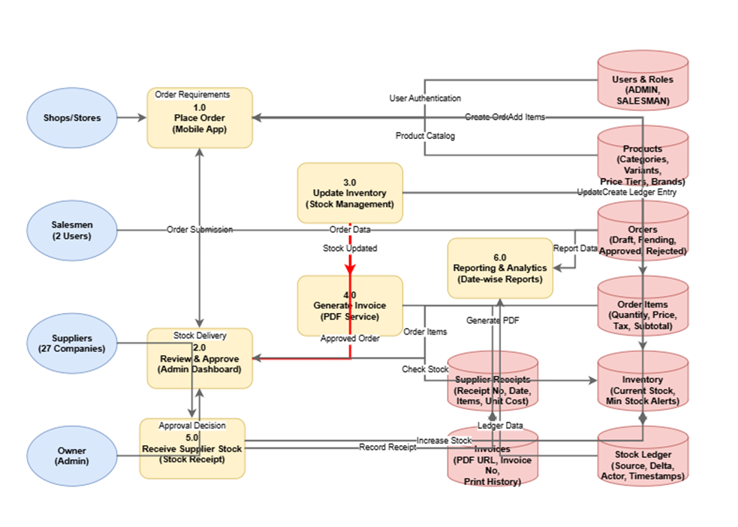
Proposed System Architecture

Slide 13
Requirement specification (Developer side )
📦 Software Stack
OS: Windows 10/11, Ubuntu server 22.04+
Backend: Next.js 14+ (Node.js 20+, App Router)
Frontend: Next.js (React 18+), Tailwind CSS 4.0, ShadCN UI
Backend: Next.js 14+ (Node.js 20+, App Router)
Database: PostgreSQL(recommended),SQLite dB (testing purpose).
Storage: Blob Storage (.xlsx, .csv formats), integrated with Node.js libraries (e.g., xlsx, papaparse).
API Layer: REST & GraphQL (via Next.js API Routes / App Router handlers)
Deployment: vps hosting using hostinger/ Docker (for on-premises or self-hosted setup)
💻 Hardware & Tools
Minimum Hardware:
CPU: Intel i5 10th Gen or Ryzen 5.
Ram : 8GB
Storage: (Preferably 512 GB SSD)
IDEs:VS Code, Cursor
(Version Control:Git 2.51.0 or later & GitHub for remote repository management
Database Tools:pgAdmin (for PostgreSQL), Turso CLI (for SQLite testing)
Servers: vps servers by hostinger
Package Management: npm 10+

Slide 14
Requirement specification (Developer side )
Functional Requirements
Implement secure REST APIs for data management and CRUD operations.
Implement secure role-based access for Owner, Salesmen, Delivery Boy, and Shopkeepers.
Develop alert and notification modules
Manage user roles and permissions securely
Auto-generate invoices in .xlsx format for completed orders.
Send stock alerts and order/delivery notifications to users.
Provide role-specific dashboards built with Next.js and Tailwind CSS.
Non -Functional Requirements
Performance – System responses within 300 ms.
Optimization: High throughput, low latency.
Security: HTTPS, JWT auth, RBAC.
Encryption: Data encrypted in transit and storage.
Reliability: 97.3% uptime, fault tolerant.
Backup: Disaster recovery in place.
Scalability: Supports Docker scaling.
Maintainability: Modular, documented code.
Usability: Intuitive interface for users.
Compliance: GDPR and privacy laws followed.

Slide 15
Requirement specification (Users side )
Software Requirements:
1.)OS: Windows 10/11 (22H2), Ubuntu 22.04+, macOS Sonoma 14+ 2.)Browser: Chrome 140+, Edge 134+, Firefox 134+ (latest stable versions) 3.)Frontend Access: Next.js 14 (React 18+ with Tailwind CSS & ShadCN UI) 4.)Authentication: NextAuth.js 5+ with JWT, role-based access (Owner, Salesmen, Delivery Boy, Shopkeeper) 5.)Database: PostgreSQL (production), Turso SQLite (testing/prototyping) 6.)Runtime/Backend: Node.js 20+ with Next.js App Router APIs 7.)Deployment: Vercel (preferred) / Docker for containerized hosting
Functional Requirements:
1.)Record shop orders through the Salesmen mobile app.
2.)View real-time inventory updates after each order/delivery.
3.)Access modules:
Order Management
Inventory Tracking
Billing & Invoicing Delivery
Assignment & Tracking
4.)Generate and download invoices/reports in .xlsx or .pdf format.
5.)Receive alerts and notifications for low stock, order approvals, and delivery status.

Slide 16
Methodology
1. Requirement Analysis
Identify stakeholders & gather functional/non-functional requirements.
Document inventory tracking, order placement, delivery, and notifications.
2. System Design
Design database & modules: Inventory, Orders, Delivery, Notifications.
Create wireframes and define technology stack (Backend, Frontend, Database).
3. Development
Build backend APIs and frontend apps (mobile & web).
Implement role-based access & real-time updates.
4. Testing
Perform unit, integration, and user acceptance testing.
Ensure performance, usability, and reliability.
5. Deployment
Host system on cloud/server.
Configure security, backups, and monitoring.
6. Maintenance
Monitor system, fix bugs, and update features.
Technologies: Node.js / SQLite,PostgreSql / Next.js / React Native.

Slide 17
Modules
User Access & Role Structure Ensures controlled access to the system by separating mobile salesman operations from dashboard administration while maintaining structured role boundaries.
Shop & Territory Management Maintains organized city-wise shop records and client databases, ensuring consistent territory structure and accurate shop information.
Sales Execution & Order Workflow Salesmen can plan routes, visit shops, browse products, and create cart-based orders with approval-based order processing.
Billing & Payment Tracking Automated GST-compliant invoice generation, digital bill storage, and payment status tracking linked with approved orders.
Dashboard & Mobile App Integration Synchronizes mobile sales operations with dashboard controls to ensure unified data flow and cross-platform consistency.

Slide 18
1. User & Role Structure
Highlights:
Salesman login interface implemented
Role separation between Mobile App and Dashboard
Profile visibility and identity display
Controlled navigation based on user role
Admin-side user visibility and monitoring
Structured access to operational features
Description: This module establishes controlled system entry by separating mobile salesman access from dashboard administration. It ensures that operational features are visible according to user role, preventing unauthorized access to restricted areas of the system.

Slide 19
2. Shop & Territory Management
Highlights:
City selection for operational context
City-wise filtered shop listing
Add new shop functionality
Shop deactivation control
Shop detail and order history view
Territory-based data organization
Description: This module manages the city-wise operational structure and maintains a consistent shop database. It allows structured organization of client records and ensures that sales activities are aligned with selected territories.

Slide 20
3. Sales & Order Execution System
Highlights:
Daily route planning and visit tracking
Product catalog browsing
Smart cart system for multi-product orders
Draft and pending order editing
Order lifecycle tracking
Dashboard order approval interface
Description: This module digitizes the full field-sales workflow, from shop visits to order placement. It ensures structured order creation and lifecycle tracking, improving operational efficiency and traceability.

Slide 21
4. Billing & Payment Tracking
Highlights:
GST invoice generation
Digital bill preview and sharing
Invoice linking with approved orders
Payment status visibility
Dashboard financial overview
Invoice persistence for later access
Outstanding balance monitoring
Description: This module converts approved orders into digital invoices and provides visibility into financial status. It ensures transparent billing and tracks outstanding payments..

Slide 22
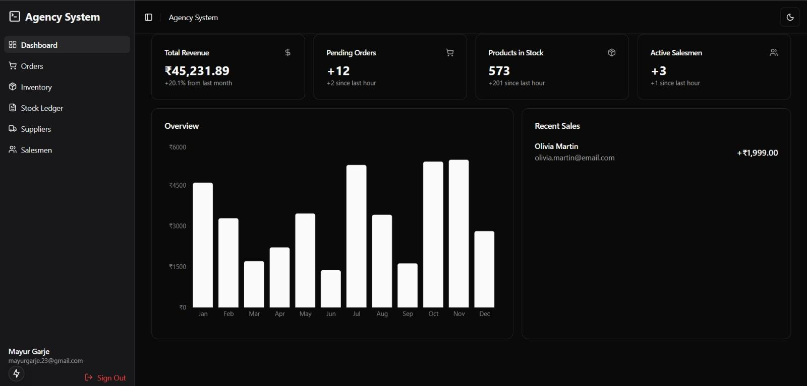
Result
Admin Dashboard :

Slide 23
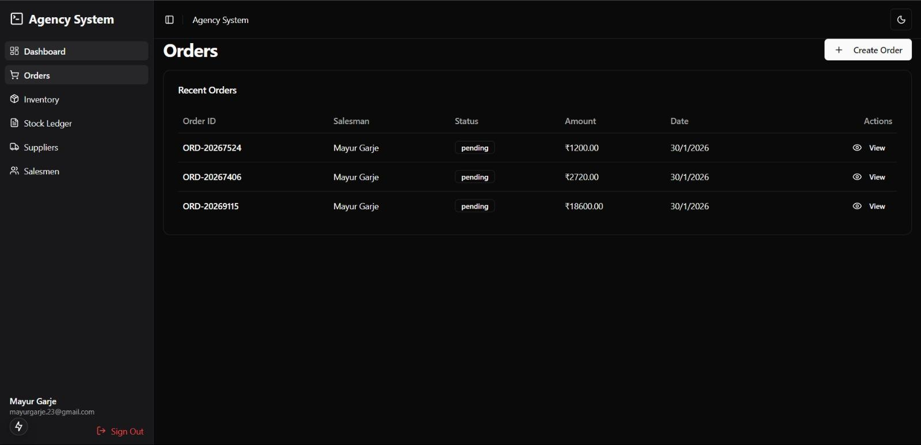
Orders :

Slide 24
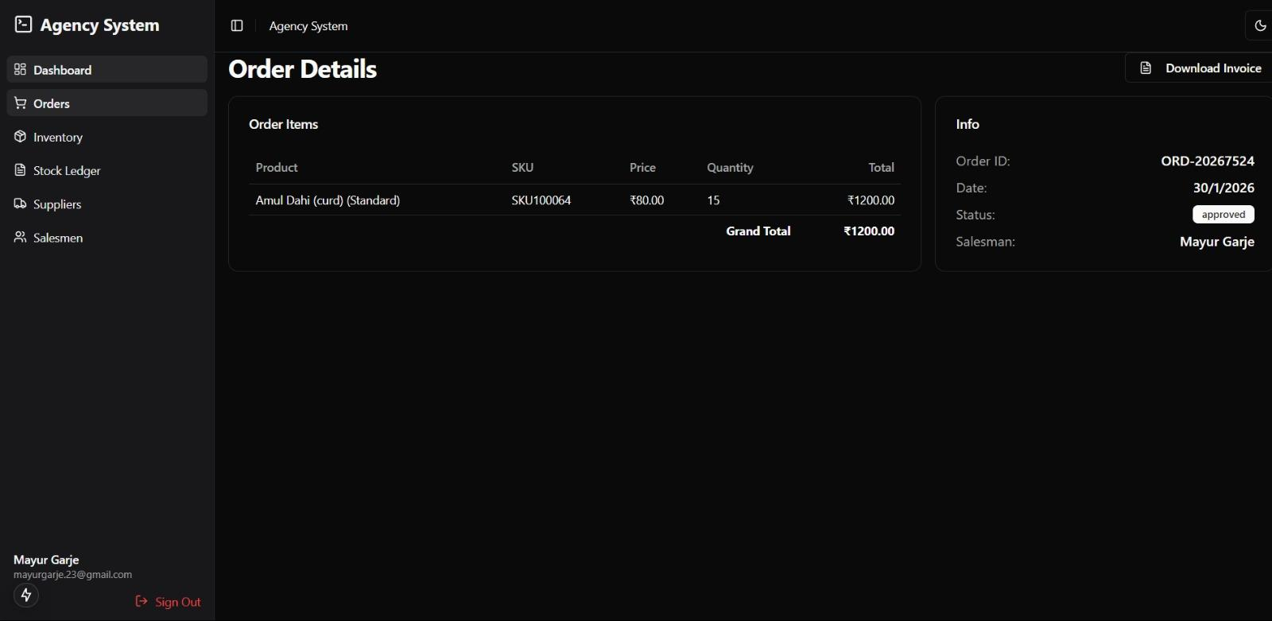
Order Detail:

Slide 25
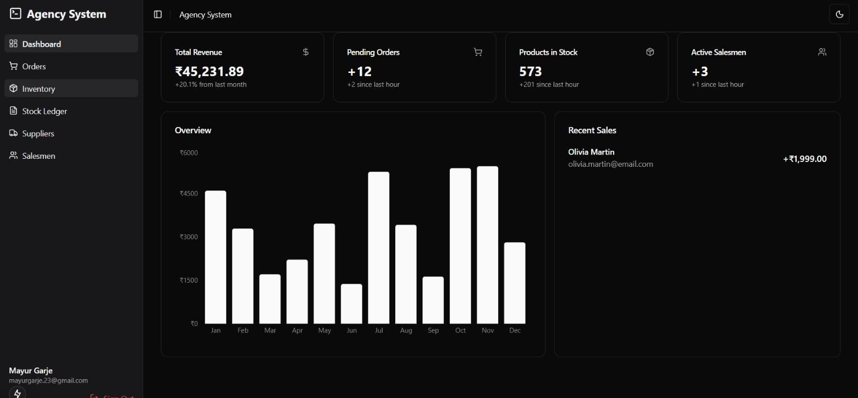
Inventory :

Slide 26
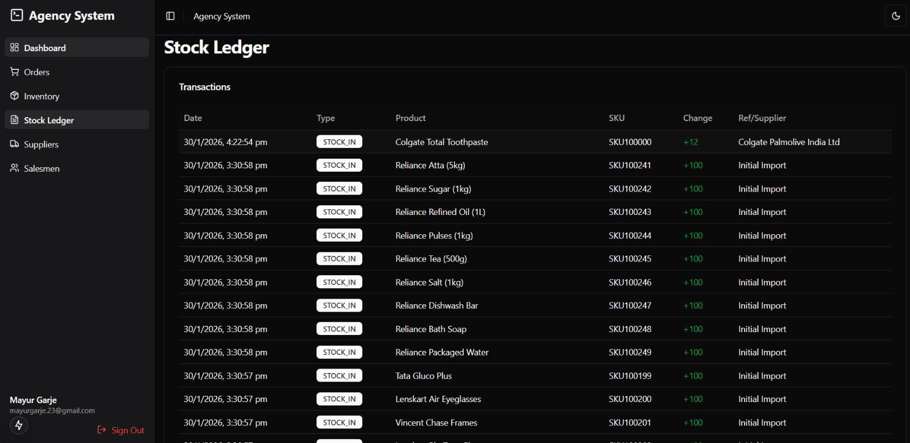
Stock Ledger :

Slide 27
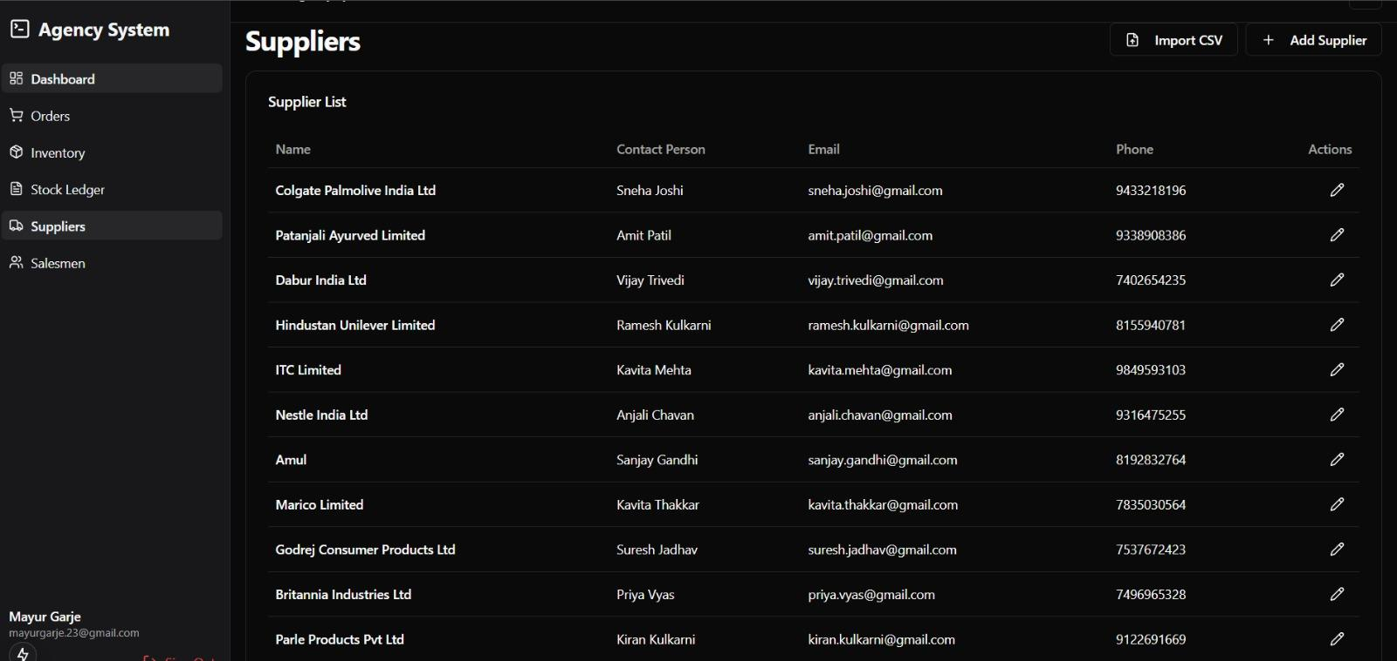
Suppliers List :

Slide 28
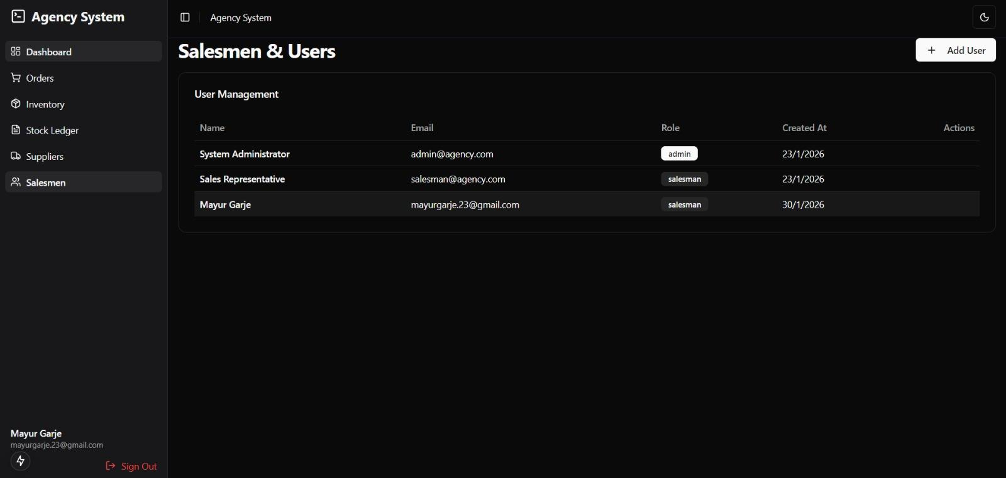
Users List :

Slide 29
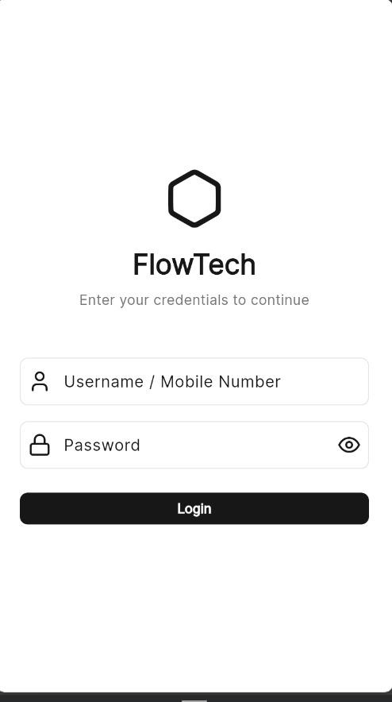
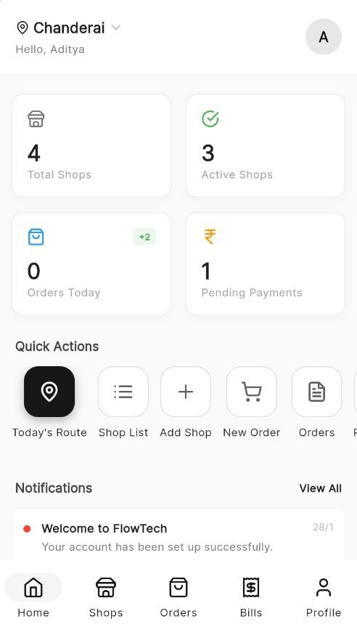
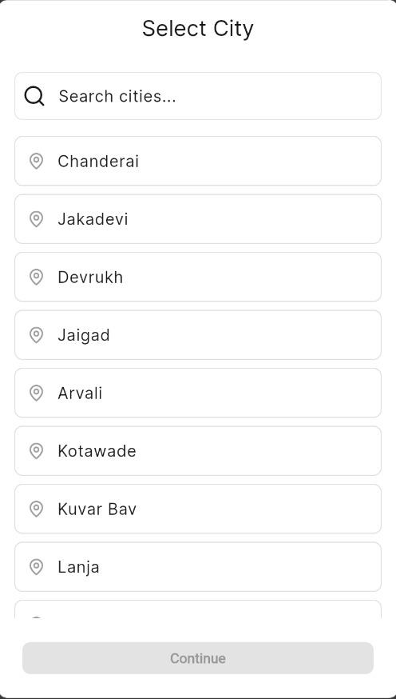
Mobile App Login page :
Home page :
Select route :

Slide 30
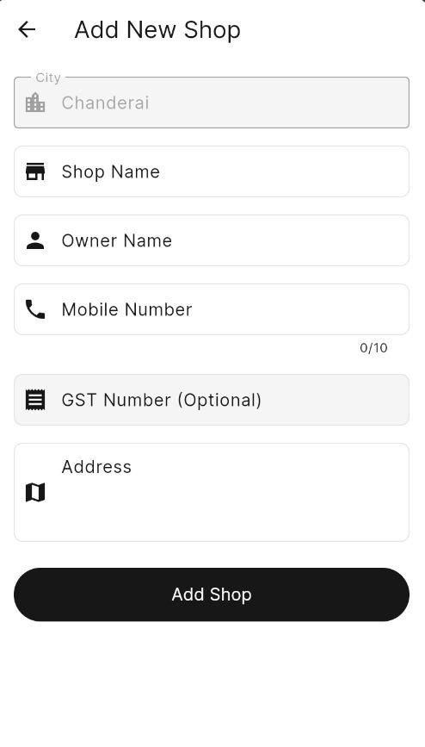
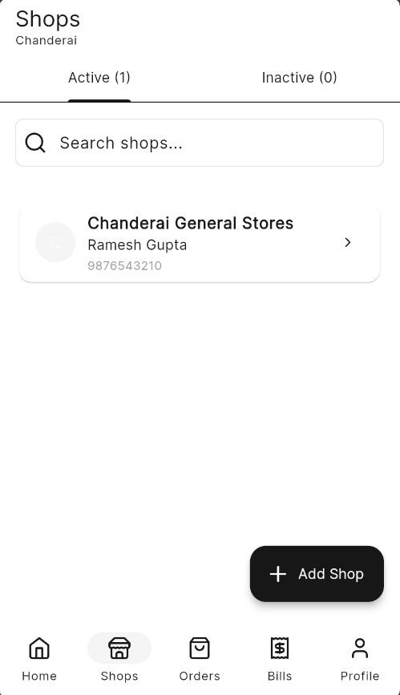
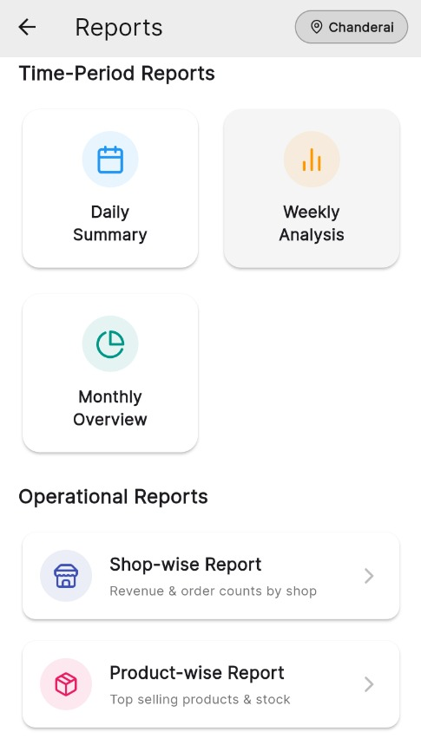
Add shop :
Shop list :
Summary and Reports :

Slide 31
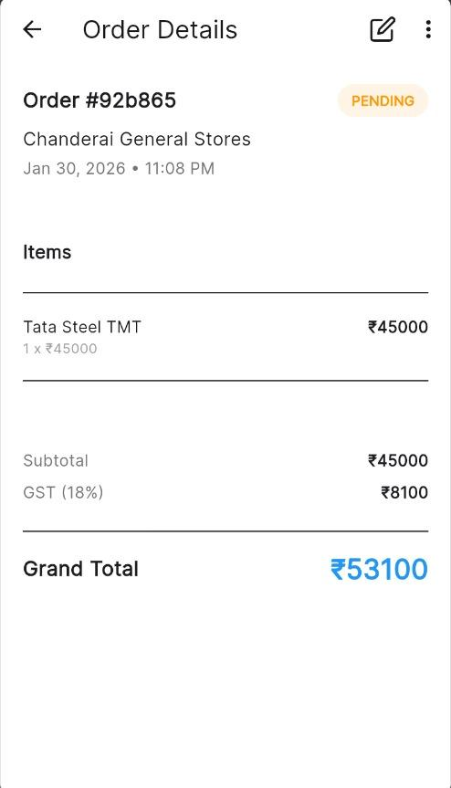
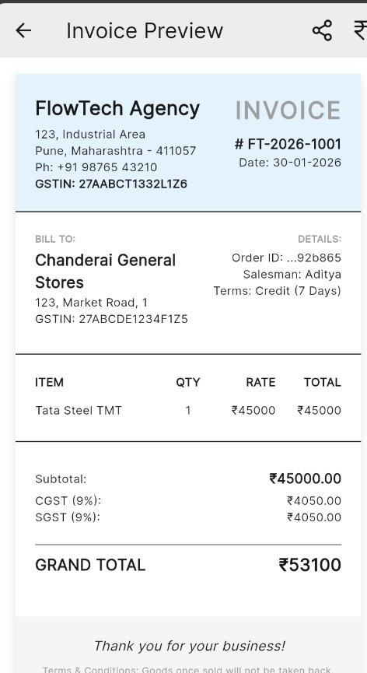
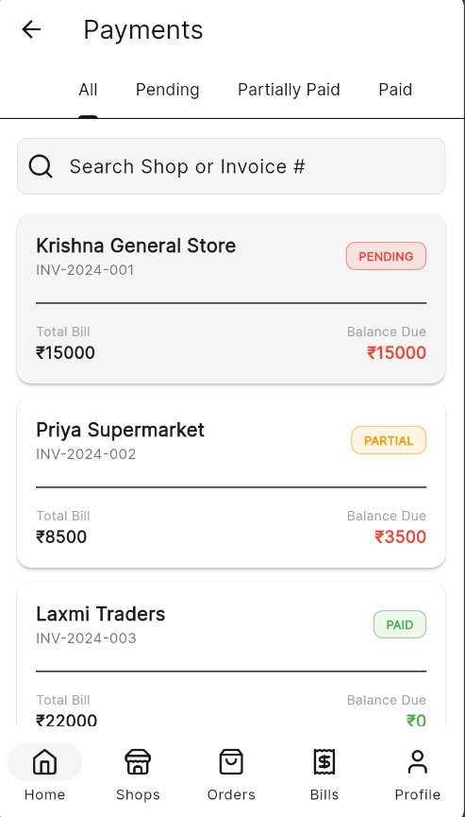
Order Detail :
GST Invoice :
Payment Status :

Slide 32
SDG Alignment
Brief Introduction: The project integrates inventory management and delivery optimization to reduce waste, improve efficiency, and ensure timely access to goods.
Relevant SDG(s):
SDG No. | Goal Name
SDG 8 | Decent Work and Economic Growth: Supports small businesses by streamlining inventory and delivery processes.
SDG 9 | Industry, Innovation, and Infrastructure: Promotes efficient digital solutions for business operations.
SDG 12 | Responsible Consumption and Production: Minimizes inventory waste and optimizes resource use.

Slide 33
References
L. Grützne, D. Voss, M.H. Breitner, "The Relationship between Inventory Management Automation and Supermarket Performance," UTHM Publisher, 2025.
P. Sahoo, S. Nanda, "Smart Inventory Management System and Predictive Analysis," Academia.edu, 2020.
R. Kumar, S. Singh, "An Advanced Inventory Management System Powered by IoT and AI," Int. J. Recent Technol. Innov., vol. 11, no. 4, pp. 1406-1413, Apr. 2025.
S. Li, P. Zhao, "Study of Smart Inventory Management System Based On IoT," Scribd, 2025.
Z. Wu, M. Chen, "Enhancing Inventory Management with Progressive Web Applications," arXiv preprint arXiv:2506.11011, 2025.
T. Svensson, "Improvements for Inventory Management Practices," Diva Portal, 2024.
R. Evans, "IoT-Based Inventory Control System: A Review," ResearchGate, 2022.
S. Naskar, "RFID in Inventory Management: A Technology Review," ResearchGate, 2016.
K. Lee, "Inventory Management 4.0 Using AI and IoT," IEEE Xplore, 2021.

Slide 34
References
E. Müller, "Mobile Applications for Inventory and Delivery Management," Springer, 2020.
P. Xu, "Cloud-Based Inventory Management Systems," MDPI Electronics, vol. 8, no. 2, pp. 153, Feb. 2020.
J. Smith, "Real-Time Inventory Tracking with IoT," Wiley Online Library, Sensors, vol. 21, no. 3, pp. 445-460, 2021.
H. Tanaka, "A Review on Warehouse Automation and Inventory Management," Elsevier, Procedia Manufacturing, vol. 51, pp. 43-52, 2022.
A. Sehgal, "AI-Driven Demand Forecasting for Inventory Management," Springer Link, Neural Comput. Appl., vol. 32, pp. 10543–10557, 2021.
S. Park, J. Kim, "Delivery Management System for Last Mile Logistics," IEEE Xplore, 2022.
M. Adams, "Mobile Delivery Applications: Enhancing Logistics," Taylor & Francis, Logistics, vol. 4, no. 1, pp. 1-15, 2023.
T. Wang, "Role-Based Access Control in Inventory Systems," ACM Digital Library, Proc. ACM Comp. Syst., vol. 16, pp. 34-44, 2020.
R. Patel, "Digital Receipt Automation for Retail," Springer, Smart Commerce, vol. 2, pp. 123-134, 2022.
Y. Li, "Inventory Management with Multi-Agent Systems," Proc. IJCAI, 2019, pp. 501–510.

Slide 35
Thank You..

